Slide 1
DECISION TREE
GINI Index
March 2023

Slide 2
DECISION TREE
INDUCE A DECISION TREE
DECISION TREE MODEL
(TRAINED)

Slide 3
Restaurant Example
“Are they willing to wait for a table in a restaurant?”
Label:
Will Wait: Yes/No
All Features:
Alternatives - Patrons - Type
Bar - Price - Estimated Time
Friday - Rain
Hunger - Reservation
YES
NO

Slide 4
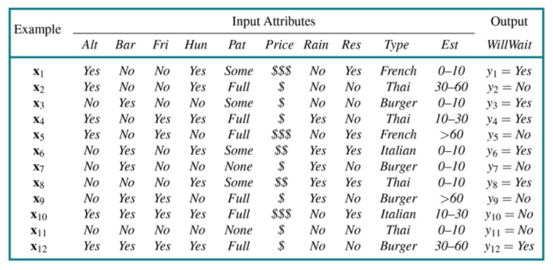
Decision Tree: Example
“Are they willing to wait for a table in a restaurant?”
Features and labels for the restaurant dataset

Slide 5
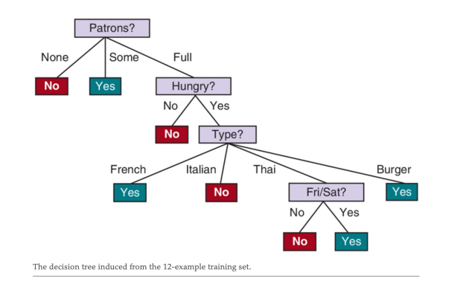
Restaurant Example
“Are they willing to wait for a table in a restaurant?”
Label:
Will Wait: Yes/No
Features Used For the tree:
Patrons (None/Some/Full)
Hunger (Yes/No)
Type (French/Italian/Thai/Burger)
Friday (Yes/No)

Slide 6
Decision Tree: Example
“Are they willing to wait for a table in a restaurant?”
Making a decision tree:
How do we branch and determine terminal node?
How do we choose which features to use for branching?

Slide 7
Legend (for the slide set)
Each row in our feature table represents a person
Blue: Yes (they waited)
Red: No (they did not wait)
FEATURES
LABELS
Patrons | Hungry | Type | Friday
Some | Yes | French | No
Full | Yes | Thai | No
Some | No | Burger | No
Full | Yes | Thai | Yes
Full | No | French | Yes
Will Wait
Yes
No
Yes
Yes
No
1
2
3
YES
NO
4
5
. . .
. . .

Slide 8
Group and Split Overview
“Persons” are grouped then split according to a feature
Start with everyone in one group
Select a feature (based on gini index)
Then split into multiple groups depending on their “answer” to the feature
1
3
4
6
8
12
2
5
7
9
10
11
Patrons?
None
Some
Full
1
3
6
8
4
12
7
11
2
5
9
10

Slide 9
Group and Split Overview
Feature: Patrons
(Are there people in the restaurant?)
Possible answers/categories:
None:
Some
Full
1
3
4
6
8
12
2
5
7
9
10
11
Patrons?

Slide 10
Group and Split Overview
Feature: Patrons
(Are there people in the restaurant?)
Possible answers/categories:
None:
Yes: 0 No: 2
Some
Full
1
3
4
6
8
12
2
5
7
9
10
11
Patrons?
None
7
11

Slide 11
Group and Split Overview
Feature: Patrons
(Are there people in the restaurant?)
Possible answers/categories:
None:
Yes: 0 No: 2
Some
Yes: 4 No: 0
Full
1
3
4
6
8
12
2
5
7
9
10
11
Patrons?
None
Some
1
3
6
8
7
11

Slide 12
Group and Split Overview
Feature: Patrons
(Are there people in the restaurant?)
Possible answers/categories:
None:
Yes: 0 No: 2
Some
Yes: 4 No: 0
Full
Yes: 2 No: 4
1
3
4
6
8
12
2
5
7
9
10
11
Patrons?
None
Some
Full
1
3
6
8
4
12
7
11
2
5
9
10

Slide 13
Group and Split Overview
None
Some
Full
What to do with new groups?
Leaf (terminal node)
All instances in the group have the same label
e.g. all yes or all no
Branch
Instances have mixed labels
e.g. mix of yes and no
Considered as a new group to split
1
3
6
8
4
12
7
11
2
5
9
10
None
Some
NO
YES
Split via new feature

Slide 14
Choosing the Feature
Patrons?
Full
None
Some
NO
YES
4
12
2
5
9
10
Split via new feature…
… But which feature?

Slide 15
Choosing the Feature
Patrons?
None
Some
Full
Why did we use the Patrons feature for branching?

Slide 16
Choosing the Feature
How do we choose which feature to use?
GINI INDEX!
For each feature, compute Gini index for each of its categories
Compute for the weighted average of the feature’s Gini indices
Select the feature with smallest (weighted average) Gini index
Patrons?
Full
None
Some
NO
YES
4
12
2
5
9
10
Split via new feature…
But which feature?

Slide 17
DECISION TREE
BRANCHING
Feature | GINI Score
Patrons | 0.28
Hungry | 0.37
Type | 0.50
Friday | 0.49
Feature ?
Patrons
?
?
FIND FEATURE WITH THE SMALLEST GINI SCORE
SPLIT/BRANCH ACCORDING TO THAT FEATURE

Slide 18
GINI Index
How do we choose which feature to use?
For each feature, compute Gini index for each of its categories
Compute for the weighted average of the feature’s Gini indices
Select the feature with smallest (weighted average) Gini index
Patrons?
None
Some
Full

Slide 19
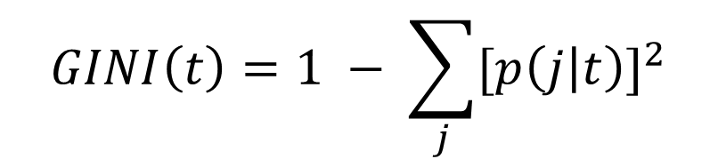
GINI Index
Measure of Impurity: GINI
t : node (e.g. the category like none/some/full for Patrons)
j : class (e.g. the label like Yes/No for Will Wait)
p ( j | t ) : relative frequency of the class in the group
$$GINI\left(t\right)=1 − \sum_{j}{{[p\left(j | t\right)]}^{2}}$$

Slide 20

DECISION TREE
GINI INDEX FOR A FEATURE
F
a
GINI(a)
$GINI(a)\left(\frac{\# in a}{total \#}\right)$ + $GINI(b)\left(\frac{\# in b}{total \#}\right)$
a
b
b
GINI(b)
PICK A FEATURE AND SPLIT
COMPUTE GINI INDEX FOR EACH NODE
GET THE WEIGHTED AVERAGE

Slide 21
Gini Index
In the Restaurant Example…
“Patrons” Feature
3 Categories (None/Some/Full)
2 Labels for Will Wait (Yes/No)
3 GINI indices:
GINI (None)
GINI (Some)
GINI (Full)
YES
None
Some
Full
1
3
6
8
4
12
NO
7
11
2
5
9
10

Slide 22
Gini Index
In the Restaurant Example…
None
Yes: 0
No: 2
Total: 2
7
11
$$GINI\left(None\right)=1 −{\left(\frac{total \# "Yes"}{total under None}\right)}^{2}−{\left(\frac{total \# "No"}{total under None}\right)}^{2}$$
$$GINI\left(None\right)=1 −{\left(\frac{0}{2}\right)}^{2}−{\left(\frac{2}{2}\right)}^{2}$$

Slide 23
Gini Index
In the Restaurant Example…
None
Yes: 0
No: 2
Total: 2
7
11
$$GINI\left(None\right)=1 −{\left(\frac{total \# "Yes"}{total under None}\right)}^{2}−{\left(\frac{total \# "No"}{total under None}\right)}^{2}$$
$$GINI\left(None\right)=1 −0 −1=0$$

Slide 24
Gini Index
In the Restaurant Example…
Some
Yes: 4
No: 0
Total: 4
1
3
6
8
$$GINI\left(Some\right)=1 −{\left(\frac{total \# "Yes"}{total under Some}\right)}^{2}−{\left(\frac{total \# "No"}{total under Some}\right)}^{2}$$
$$GINI\left(Some\right)=1 −{\left(\frac{4}{4}\right)}^{2}−{\left(\frac{0}{4}\right)}^{2}$$

Slide 25
Gini Index
In the Restaurant Example…
Some
Yes: 4
No: 0
Total: 4
1
3
6
8
$$GINI\left(Some\right)=1 −{\left(\frac{total \# "Yes"}{total under Some}\right)}^{2}−{\left(\frac{total \# "No"}{total under Some}\right)}^{2}$$
$$GINI\left(Some\right)=1 −1−0=0$$

Slide 26
Gini Index
In the Restaurant Example…
Full
Yes: 2
No: 4
Total: 6
4
12
2
5
9
10
$$GINI\left(Full\right)=1 −{\left(\frac{total \# "Yes"}{total under Full}\right)}^{2}−{\left(\frac{total \# "No"}{total under Full}\right)}^{2}$$
$$GINI\left(Full\right)=1 −{\left(\frac{2}{6}\right)}^{2}−{\left(\frac{4}{6}\right)}^{2}$$

Slide 27
Gini Index
In the Restaurant Example…
Full
Yes: 2
No: 4
Total: 6
4
12
2
5
9
10
$$GINI\left(Full\right)=1 −{\left(\frac{total \# "Yes"}{total under Full}\right)}^{2}−{\left(\frac{total \# "No"}{total under Full}\right)}^{2}$$
$$GINI\left(Full\right)=1 −0.111−0.444=0.56$$

Slide 28
GINI Index
How do we choose which feature to use?
For each feature, compute Gini index for each of its categories
Compute for the weighted average of the feature’s Gini indices
Select the feature with smallest (weighted average) Gini index
Patrons?
None
Some
Full
GINI (None) = 0
GINI (Some) = 0
GINI (Full) = 0.55

Slide 29
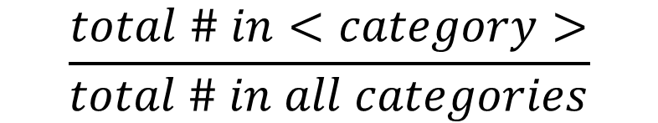




GINI Index
Computing for Weighted Average:
For each category, multiply GINI(category) by:
Then sum all values to get the weighted average
Also called
Patrons?
$$\frac{total \# in<category>}{total \# in all categories}$$
None
Some
Full
GINI($None)\frac{2}{12}$
GINI(Some)$\frac{4}{12}$
GINI(Full)$\frac{6}{12}$
$${GINI}_{split}$$

Slide 30
GINI Index
Total # in None: 2
Total # in Some: 4
Total # in Full: 6
Total # in all: 12
GINI (None) = 0
GINI (Some) = 0
GINI (Full) = 0.56
Patrons?
None
Some
Full
${GINI}_{split}=GINI\left(None\right)\frac{total \# in None}{total \# in all}+GINI(Some)\frac{total \# in Some}{total \# in all}$ + $GINI(Full)\frac{total \# in Full}{total \# in all}$

Slide 31
GINI Index
Total # in None: 2
Total # in Some: 4
Total # in Full: 6
Total # in all: 12
GINI (None) = 0
GINI (Some) = 0
GINI (Full) = 0.56
Patrons?
None
Some
Full
${GINI}_{split}=GINI\left(None\right)\frac{total \# in None}{total \# in all}+GINI(Some)\frac{total \# in Some}{total \# in all}$ + $GINI(Full)\frac{total \# in Full}{total \# in all}$
${GINI}_{split}=GINI(None)\left(\frac{2}{12}\right)+GINI(Some)\left(\frac{4}{12}\right)$+ $GINI(Full)\left(\frac{6}{12}\right)$

Slide 32
GINI Index
Total # in None: 2
Total # in Some: 4
Total # in Full: 6
Total # in all: 12
GINI (None) = 0
GINI (Some) = 0
GINI (Full) = 0.56
Patrons?
None
Some
Full
${GINI}_{split}=GINI\left(None\right)\frac{total \# in None}{total \# in all}+GINI(Some)\frac{total \# in Some}{total \# in all}$ + $GINI(Full)\frac{total \# in Full}{total \# in all}$
${GINI}_{split}=GINI(None)\left(\frac{2}{12}\right)+GINI(Some)\left(\frac{4}{12}\right)$+ $GINI(Full)\left(\frac{6}{12}\right)$
${GINI}_{split}=0(\frac{2}{12})+0(\frac{4}{12})$ + $0.56\left(\frac{6}{12}\right)=0.28$

Slide 33
GINI Index
How do we choose which feature to use?
For each feature, compute Gini index for each of its categories
Compute for the weighted average of the feature’s Gini indices
Select the feature with smallest (weighted average) Gini index
Patrons?
None
Some
Full
GINI for Patrons: 0.28

Slide 34
GINI Index
How do we choose which feature to use?
For each feature, compute Gini index for each of its categories
Compute for the weighted average of the feature’s Gini indices
Select the feature with smallest (weighted average) Gini index
Hungry?
Yes
No
GINI for Patrons: 0.28
GINI for Hungry: _______

Slide 35
Gini Index
In the Restaurant Example…
“Hungry” Feature
2 Categories for hungry (Yes/No)
2 Labels for Will Wait (Yes/No)
2 GINI indices:
GINI (Hungry)
GINI (Not Hungry)
YES
Yes (Hungry)
No (Not Hungry)
NO

Slide 36
Gini Index
In the Restaurant Example…
Yes (Hungry)
Yes: 5
No: 2
Total: 7
$$GINI\left(Hungry\right)=1 −{\left(\frac{total \# "Yes"}{total under Hungry}\right)}^{2}−{\left(\frac{total \# "No"}{total under Hungry}\right)}^{2}$$
$$GINI\left(Hungry\right)=1 −{\left(\frac{5}{7}\right)}^{2}−{\left(\frac{2}{7}\right)}^{2}$$

Slide 37
Gini Index
In the Restaurant Example…
Yes (Hungry)
Yes: 5
No: 2
Total: 7
$$GINI\left(Hungry\right)=1 −{\left(\frac{total \# "Yes"}{total under Hungry}\right)}^{2}−{\left(\frac{total \# "No"}{total under Hungry}\right)}^{2}$$
$$GINI\left(Hungry\right)=1 −0.51−0.08=0.41$$

Slide 38
Gini Index
In the Restaurant Example…
No (Not Hungry)
Yes: 1
No: 4
Total: 5
$$GINI\left(Not Hungry\right)=1 −{\left(\frac{total \# "Yes"}{total under Not Hungry}\right)}^{2}−{\left(\frac{total \# "No"}{total under Not Hungry}\right)}^{2}$$
$$GINI\left(Not Hungry\right)=1 −{\left(\frac{1}{5}\right)}^{2}−{\left(\frac{4}{5}\right)}^{2}$$

Slide 39
Gini Index
In the Restaurant Example…
No (Not Hungry)
Yes: 1
No: 4
Total: 5
$$GINI\left(Not Hungry\right)=1 −{\left(\frac{total \# "Yes"}{total under Not Hungry}\right)}^{2}−{\left(\frac{total \# "No"}{total under Not Hungry}\right)}^{2}$$
$$GINI\left(Not Hungry\right)=1 −0.04−0.64=0.32$$

Slide 40
GINI Index
How do we choose which feature to use?
For each feature, compute Gini index for each of its categories
Compute for the weighted average of the feature’s Gini indices
Select the feature with smallest (weighted average) Gini index
Hungry?
Yes
No
GINI(Hungry) = 0.41
GINI(Not Hungry) = 0.32

Slide 41
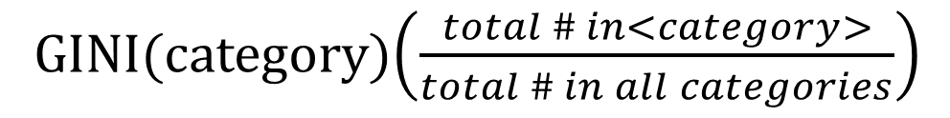
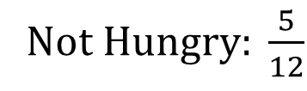
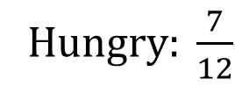
GINI Index
Weighted Average
Sum of the following value for all categories:
Hungry?
GINI(category)$\left(\frac{total \# in<category>}{total \# in all categories}\right)$
Yes
No
H$ungry: \frac{7}{12}$
Not H$ungry: \frac{5}{12}$

Slide 42
GINI Index
Total # in Hungry: 7
Total # in Not Hungry: 5
Total # in all: 12
GINI (Hungry) = 0.41
GINI (Not Hungry) = 0.32
Hungry?
Yes
No
${GINI}_{split}=GINI\left(Hungry\right)\frac{total \# in Hungry}{total \# in all}+GINI(Not Hungry)\frac{total \# in Not Hungry}{total \# in all}$

Slide 43
GINI Index
Total # in Hungry: 7
Total # in Not Hungry: 5
Total # in all: 12
GINI (Hungry) = 0.41
GINI (Not Hungry) = 0.32
Hungry?
Yes
No
${GINI}_{split}=GINI\left(Hungry\right)\frac{total \# in Hungry}{total \# in all}+GINI(Not Hungry)\frac{total \# in Not Hungry}{total \# in all}$
$${GINI}_{split}=GINI(Hungry)\left(\frac{7}{12}\right)+GINI(Not Hungry)\left(\frac{5}{12}\right)$$

Slide 44
GINI Index
Total # in Hungry: 7
Total # in Not Hungry: 5
Total # in all: 12
GINI (Hungry) = 0.41
GINI (Not Hungry) = 0.32
Hungry?
Yes
No
${GINI}_{split}=GINI\left(Hungry\right)\frac{total \# in Hungry}{total \# in all}+GINI(Not Hungry)\frac{total \# in Not Hungry}{total \# in all}$
$${GINI}_{split}=GINI(Hungry)\left(\frac{7}{12}\right)+GINI(Not Hungry)\left(\frac{5}{12}\right)$$
$${GINI}_{split}=0.41\left(\frac{7}{12}\right)+0.32\left(\frac{5}{12}\right)=0.37$$

Slide 45
GINI Index
How do we choose which feature to use?
For each feature, compute Gini index for each of its categories
Compute for the weighted average of the feature’s Gini indices
Select the feature with smallest (weighted average) Gini index
Hungry?
Yes
No
GINI for Patrons: 0.28
GINI for Hungry: 0.37
GINI for Type: 0.5
GINI for Fri/Sat: 0.49

Slide 46
Decision Tree: Example
Restaurant Example:
The feature Patrons is used as the root node because it has the smallest GINI index
GINI for Patrons: 0.28
GINI for Hungry: 0.37
GINI for Type: 0.5
GINI for Fri/Sat: 0.49

Slide 47
Summary
INDUCE A DECISION TREE
DECISION TREE MODEL
(TRAINED)

Slide 48
Summary
BRANCHING
Feature | GINI Score
Patrons | 0.28
Hungry | 0.37
Type | 0.50
Friday | 0.49
Feature ?
Patrons
?
?
FIND FEATURE WITH THE SMALLEST GINI SCORE
SPLIT/BRANCH ACCORDING TO THAT FEATURE

Slide 49
Summary
GINI INDEX FOR A FEATURE
F
a
GINI(a)
$GINI(a)\left(\frac{\# in a}{total \#}\right)$ + $GINI(b)\left(\frac{\# in b}{total \#}\right)$
a
b
b
GINI(b)
PICK A FEATURE AND SPLIT
COMPUTE GINI INDEX FOR EACH NODE
GET THE WEIGHTED AVERAGE

